Slide 1
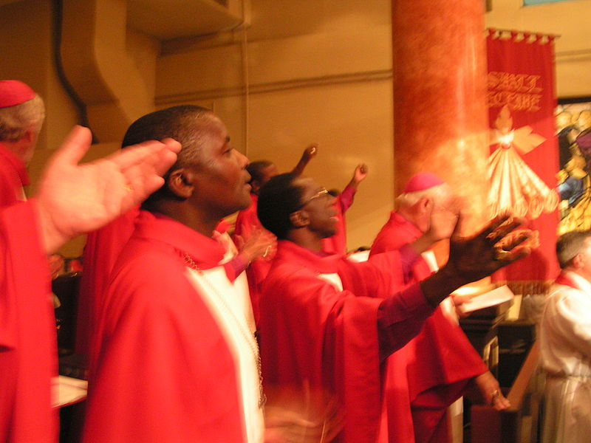
People worship and pray in different ways.

Slide 2
What does ‘worship’ mean?

Slide 3
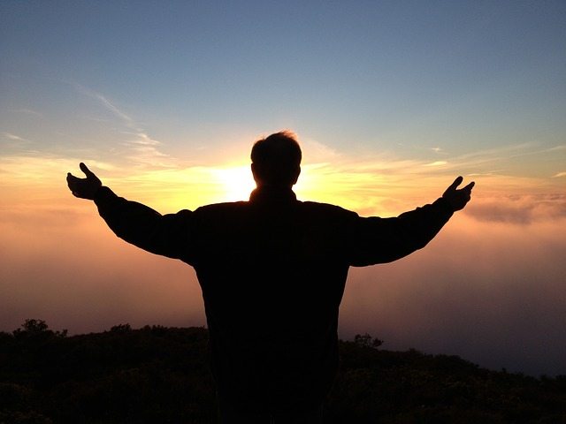
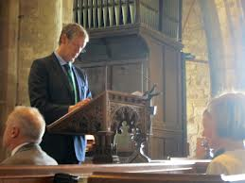
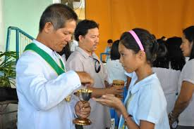
singing
praying
Worship can take different forms
reading, speaking, listening
Communion/Mass

Slide 4
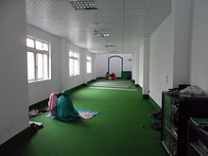
Sometimes worship can be big and loud
But sometimes it can be still and small

Slide 5
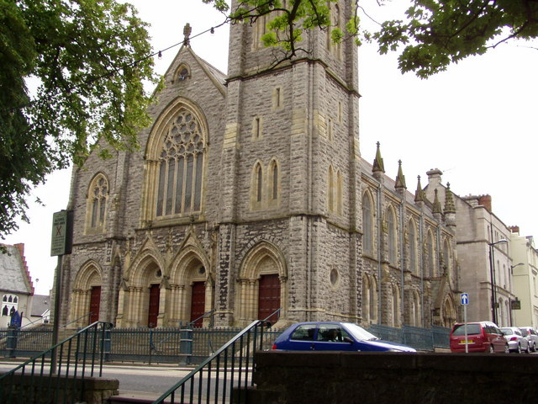
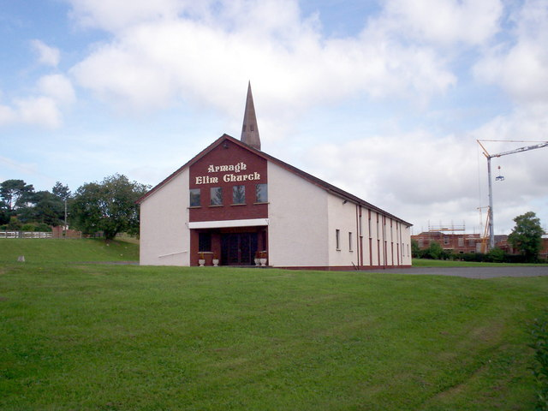
People worship and pray in different places

Slide 6
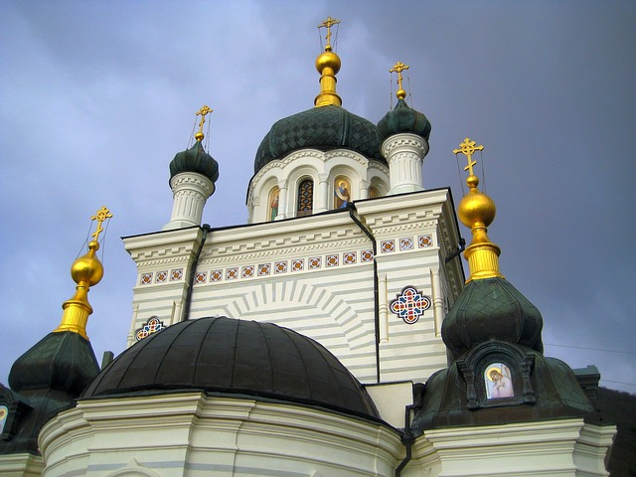
Some are grand

Slide 7
Some are simple

Slide 8
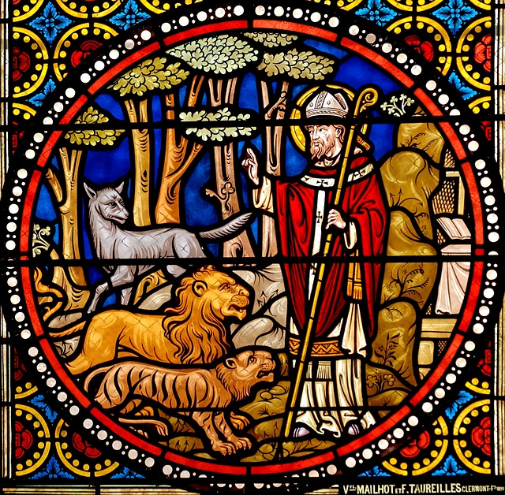
Some have beautiful stained-glass windows

Slide 9
But you don’t have to be inside a church to worship or pray.

Slide 10
These men are praying outside, in a special place in Jerusalem.

Slide 11
These people have come to pray outside, in a special place called Mecca.

Slide 12
And these people are praying outside in Rome.

Slide 13
People pray at home too.

Slide 14
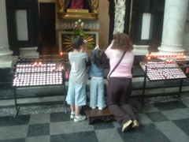
People pray in different ways.
Some people kneel.

Slide 15
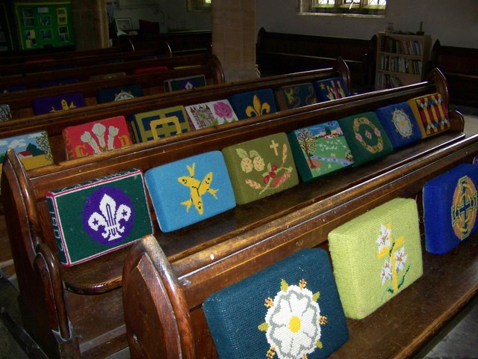
These churches have lots of lovely kneelers. Have you ever seen any like these?

Slide 16
Some people stand to pray.

Slide 17
Some people sit quietly when they pray.

Slide 18
Some people touch their foreheads to the ground when they pray.
Photo by: Antonio Melina/Agência Brasil

Slide 19
Some people pray with their hands together.

Slide 20
Some people pray with their hands lifted up.

Slide 21
Sometimes people pray together.

Slide 22
Sometimes people pray all by themselves.

Slide 23
Some people have things that help them to pray
like candles

Slide 24
or beads

Slide 25
The light and the beautiful colours of stained -glass windows
can help us to pray.

Slide 26
Some people use prayer books.
This man is wearing a special cap on his head and has wrapped special prayer boxes on his arm and forehead.

Slide 27
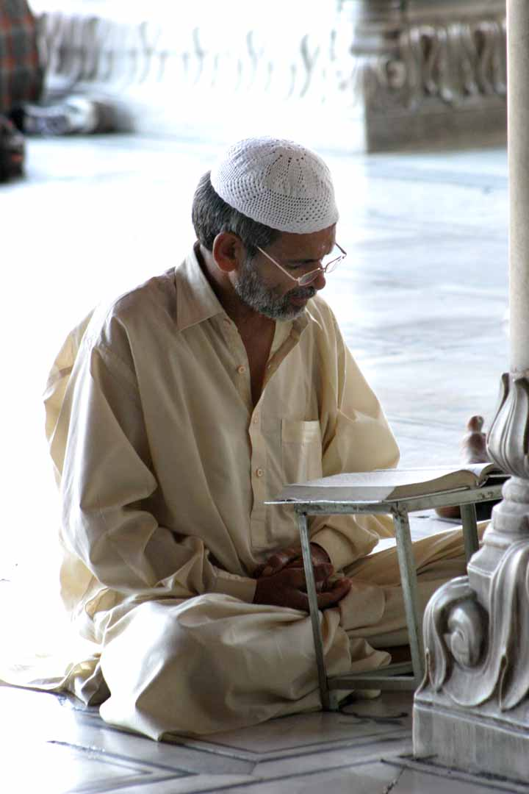
Some people cover their heads when they pray.

Slide 28
People pray at different times.
Some pray before
they eat.
Sometimes this
is called ‘saying grace’.

Slide 29
People say prayers before they go to sleep.

Slide 30
Some people can gather to pray as many as eight times a day!

Slide 31
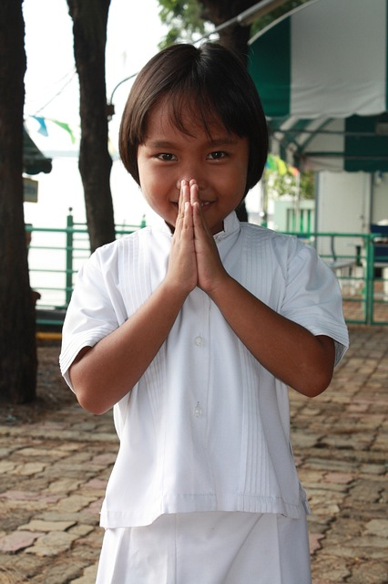
People worship and pray in different ways.
How do you worship and pray?

